Slide 1
BCOG 200
Lecture 11
Machine Learning

Slide 2
Lecture Topics
What is machine learning, and what is it good for?
What are the three main branches of machine learning
Statistics vs. machine learning vs. computational modeling

Slide 3
Machine learning: Any algorithm that improves automatically through experience
What is it, and what is it good for?
Advanced data analysis, models, and prediction of data from any field
Business, industry, and finance
Government and Public Policy
Science and Research
Simulations and Models of the Human Mind
AI vs. Machine Learning vs. Human Intelligence

Slide 4
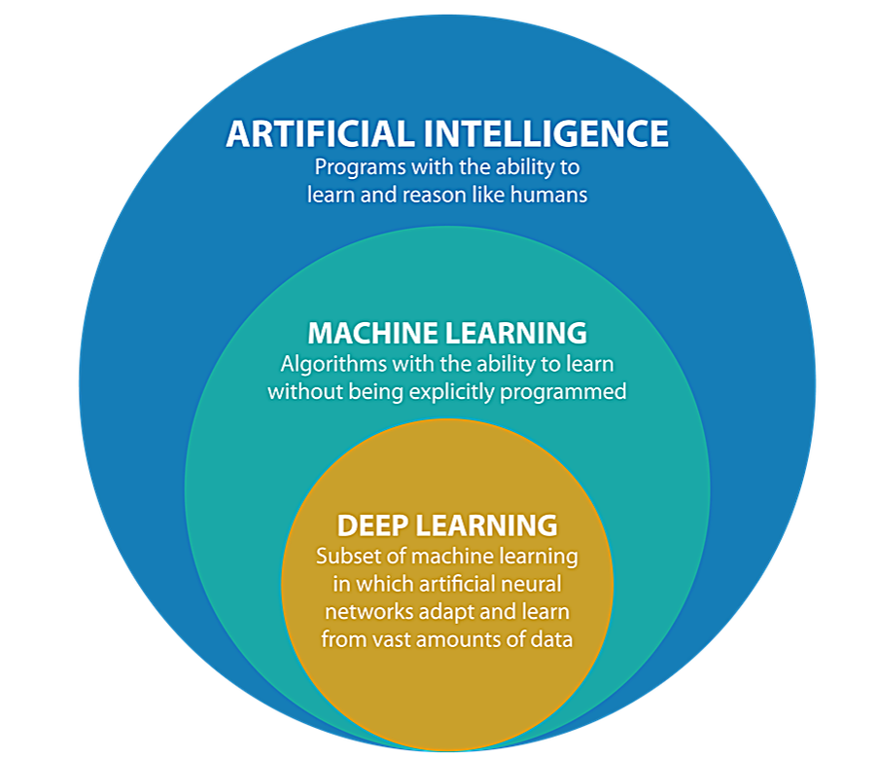
AI vs. Machine Learning

Slide 5
Three Branches of Machine Learning
Unsupervised Learning - You have some data, and and no teacher or feedback or explicit goal, and you are just trying to organize the data
Supervised Learning - You have some data, and are being explicitly told some relationship you are trying to learn
Reinforcement Learning - You have some input data, and are trying to learn the right thing to DO given that situation.

Slide 6
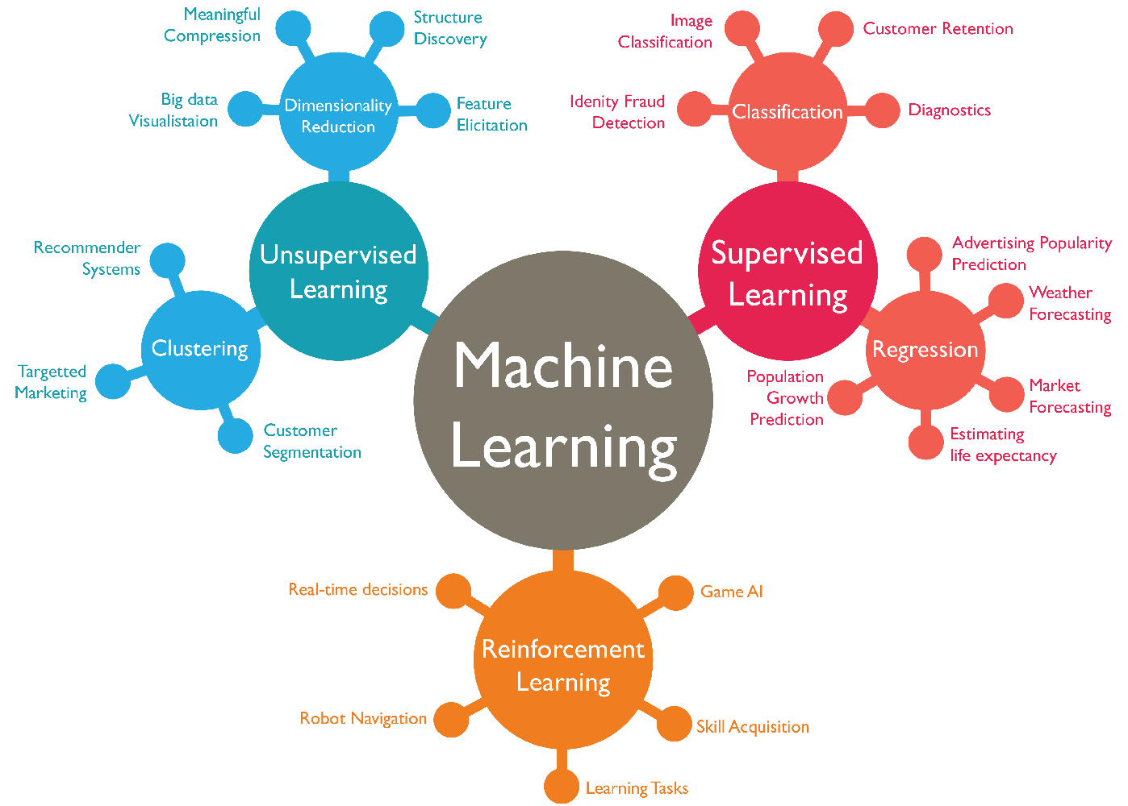
Machine Learning

Slide 7
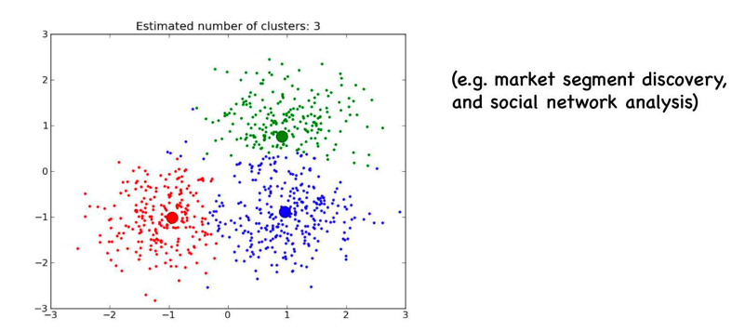
Unsupervised Learning - Clustering
Clustering

Slide 8
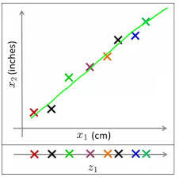
Unsupervised Learning - Dimensionality Reduction
If information is represented in multiple, redundant ways, you can simplify!
This 2-D information can be compressed to a 1-D representation.

Slide 9
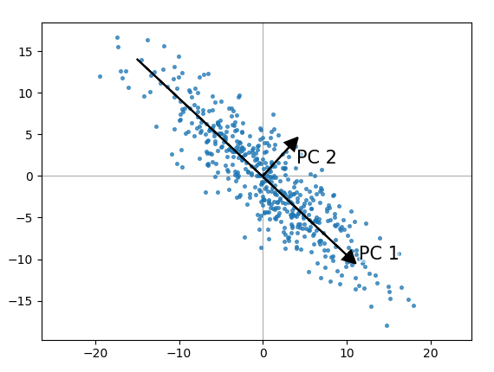
Unsupervised Learning - Dimensionality Reduction
Principal Components Analysis:
Take original information
Draw orthogonal lines, one at a time, in manner than minimizes distance of each line to all the points.
Calculate out how much variance is explained by each dimension
Convert each observation to a score on that dimension.
In example on left, PC1 has much higher variance than PC2 (maybe 5:1 ratio).
If we represent a point as its value on PC1, we are capturing ⅚ of the point’s original information, using less ½ of the dimensions.

Slide 10
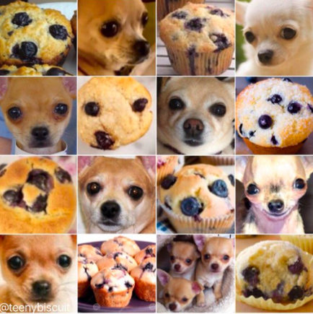
Supervised Learning

Slide 11
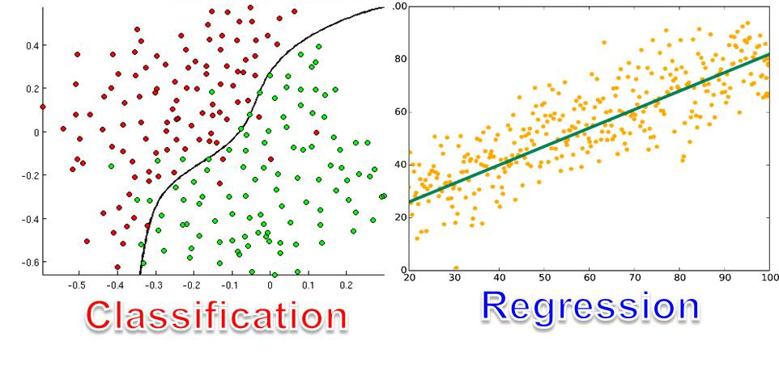
Supervised Learning
Predict a categorical/binary answer
(is it in this group, yes or no?)
Predict a categorical/binary answer
(is it in this group, yes or no?)

Slide 12
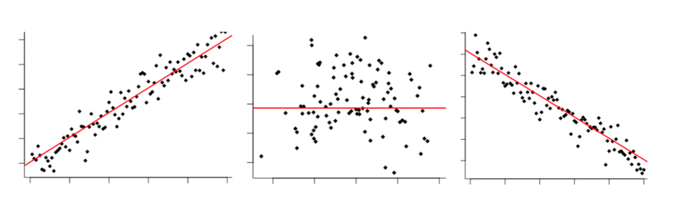
Supervised Learning - Regression
Use y = mx + b as a model of data, try to find values of m and b (slope and intercept) that best predict the data

Slide 13
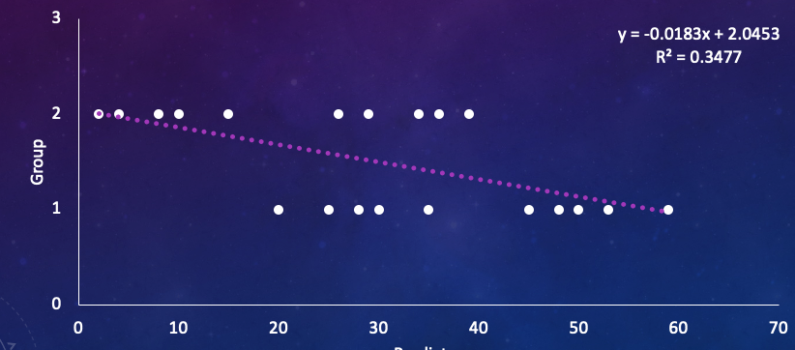
Classification - Logistic Regression
Linear Regression, doesn’t work well for categorical data

Slide 14
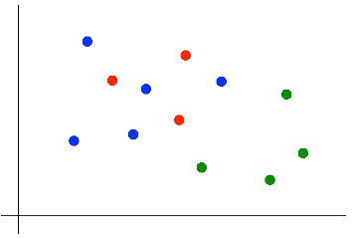
Classification - K Nearest Neighbors
Suppose we want to predict the color of the gray dot.
1) Pick a value for k.
2) Find colors of k nearest neighbors.
3) Assign the most common color
to the gray dot.

Slide 15
Classification - K Nearest Neighbors
Advantages of KNN:
Simple to understand and explain
Model training phase is fast
Non-parametric (does not presume a “form” of the “decision boundary”)
Disadvantages of KNN:
Prediction phase can be slow when n is large
Parametric methods will be better than KNN if the selected form is close to the “true” form
Parametric methods tend to be better than KNN for small n and large p (in other words, KNN overfits)
Weights all features more or less equally
Does not provide coefficients or p-values
Sensitive to irrelevant features
Sensitive to unscaled data

Slide 16
Classification - Logistic Regression
Linear Regression, doesn’t work well for categorical data
 | Quantitative Predictor(s) | Qualitative Predictor(s)
Quantitative Outcome(s) | Regression | ANOVA
Qualitative Outcome(s) | Logistic Regression | Chi-Square

Slide 17
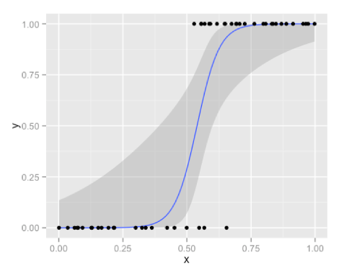
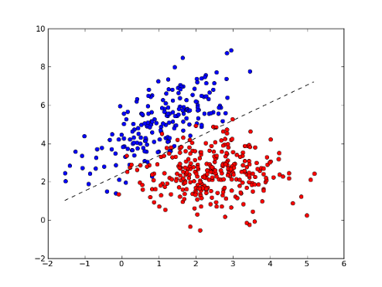
Classification - Logistic Regression
Instead of y = mx + b, use y = 1 / (1 + e^{(-(mx+b))})
Trying to find a value of m and b (slope and intercept) that minimizes distance of all points to curve on the left, and/or which gets as many dots as possible on the correct side of the decision line on the right

Slide 18
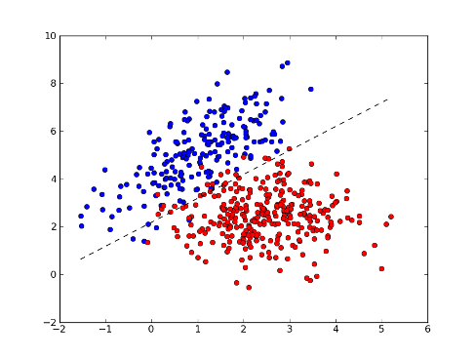
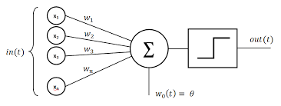
Logistic Regression and Neural Networks

Slide 19
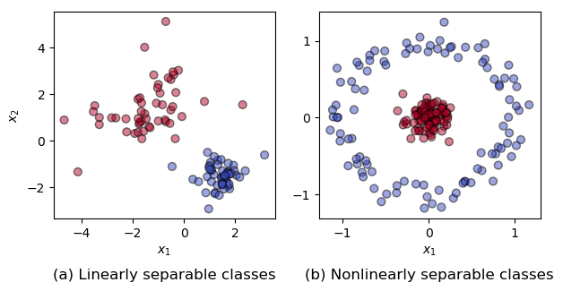
Requires Linear Separability

Slide 20
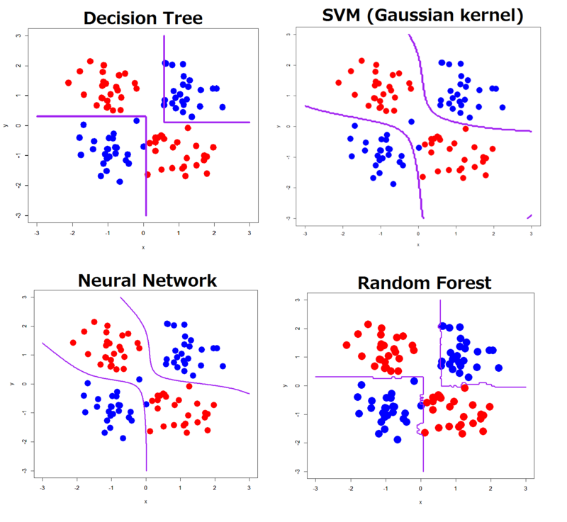
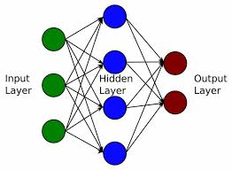
Hidden Layers
Deep Neural Network

Slide 21
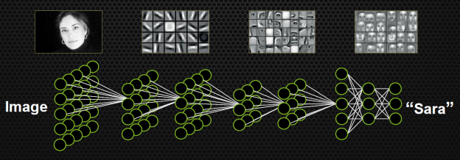
Deep Learning

Slide 22
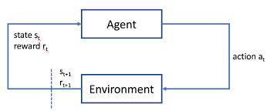
Reinforcement Learning

Slide 23
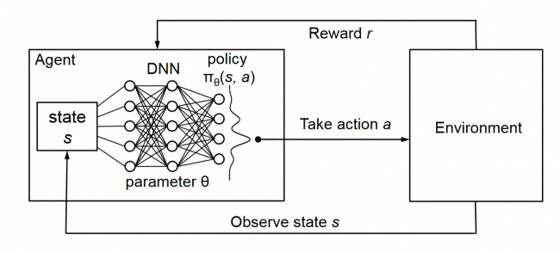
Reinforcement Learning

Slide 24
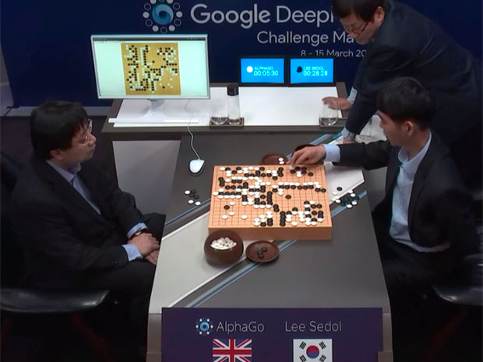
Reinforcement Learning

Slide 25


Slide 26
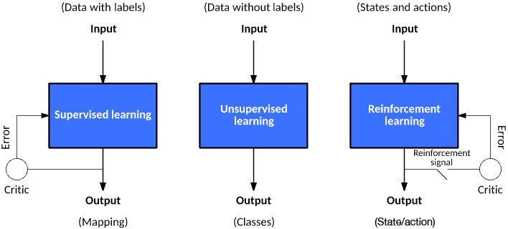

Slide 27
Continuum of Complexity
Statistics → Machine Learning → Computational Models
Statistics are about using data to make inferences and predictions
Machine learning is what we tend call it when the learning or data representation gets more complex, like using giant datasets, or a deep neural network rather than simple logistic regression using many predictors to predict many outcomes.
Computational modeling or computational science is what we tend to call it when we are moving beyond descriptive explanations, and trying to model or simulate the process

Slide 28
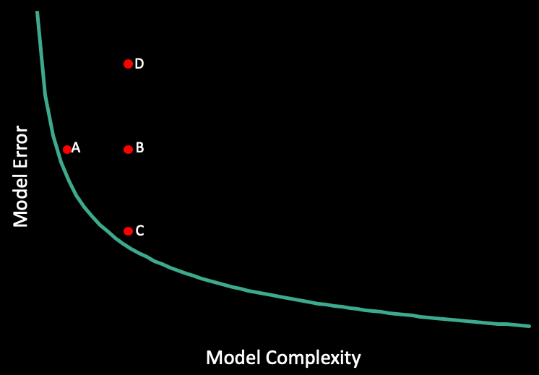

Slide 29
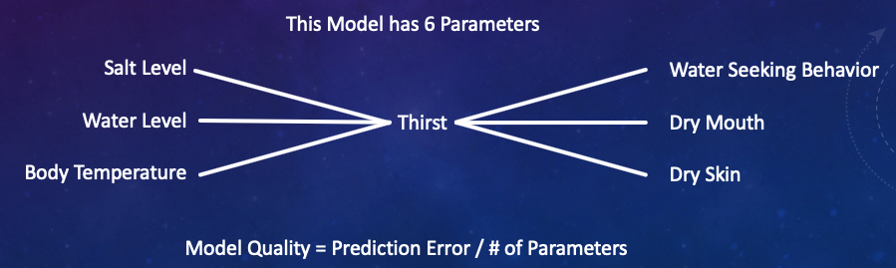
What is the point of a model? Or really, of science in general?
Prediction? Explanation? Accurate depiction of reality?
Thirst example

